Slide 1

IOT BASED BANK LOCKER SECURITY SYSTEM

Slide 2
POWER MANAGEMENT
SUBMITTED BY: KIRANPREET KAUR GILL(C0761396)
GROUP: #2

Slide 3

UNTIL NOW
Before starting the task, initially we will review what all we have done till now with respect to the project that we had proposed.
Till now, we are done with the interfacing of buzzer, Servo motor, Vibration sensor, Arduino mega, Fingerprint sensor, GSM SIM900 Module, ESP8266 Module, ESP32 Module, Touchscreen and RTC Module with beaglebone black successfully.
In order to make interfacing possible we used various functions and features of C programming and various communication protocols are used such as UART, SPI, I2C and GPIO that required various libraries as to gain the control over GPIO pins we installed “iobb library”, Adafruit fingerprint library, etc.
After the successful interfacing of all the components, also desgining the PCB online with the Zero PCB Implementation; the final task is power management..

Slide 4
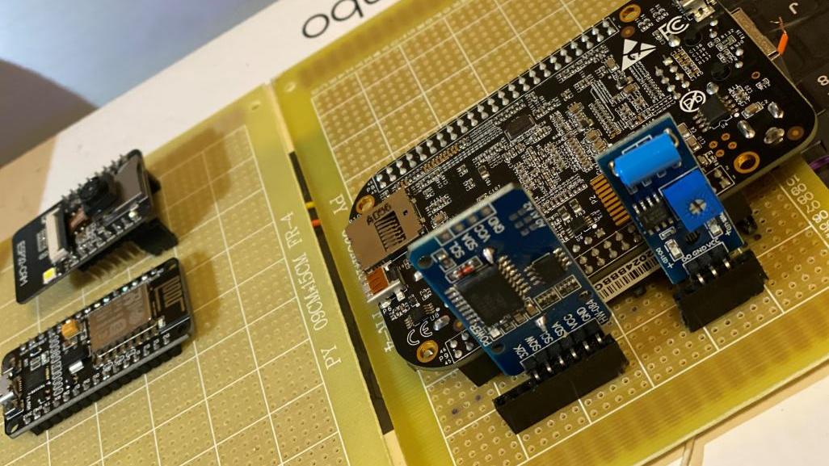
TASK OBJECTIVE
In today’s task the main objective is to learn about the power required by each component to operate and putting the beaglebone black on sleep mode.

Slide 5
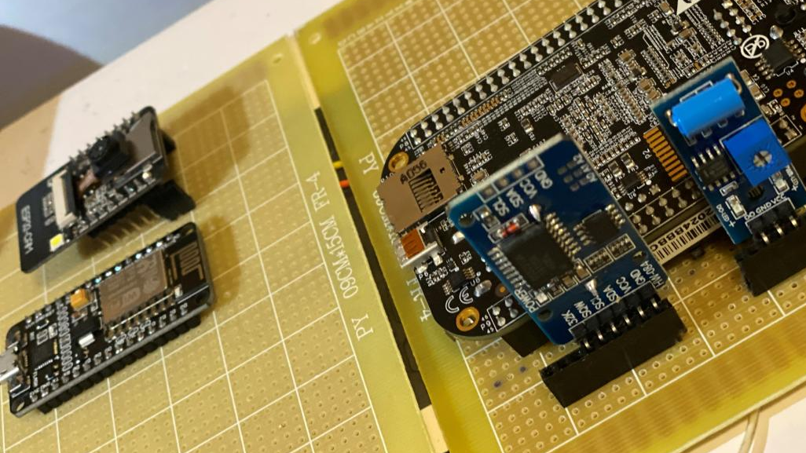
INTRODUCTION
In today’s task we try to put the beaglebone black on the sleep mode to manage the power and the power requirement of each component.
In order to complete this task, the hardware requirements are beaglebone black, USB cable, and, the software requirements are GNU Nano editor, terminal and GCC compiler.

Slide 6
WHAT IS POWER MANAGEMENT??
In modern embedded systems software takes an increasing responsibility for power management. Therefore, power management is achieved while a device is operating and looks at the techniques employed to minimize power consumption when a device is inactive.

Slide 7

WHY POWER MANAGEMENT IS IMPORTANT ??
The importance of power management in today’s embedded designs has been steadily growing as an increasing number of battery powered devices are developed.
So, there is always a need to extend battery life and/or reduce the environmental impact of a system.

Slide 8
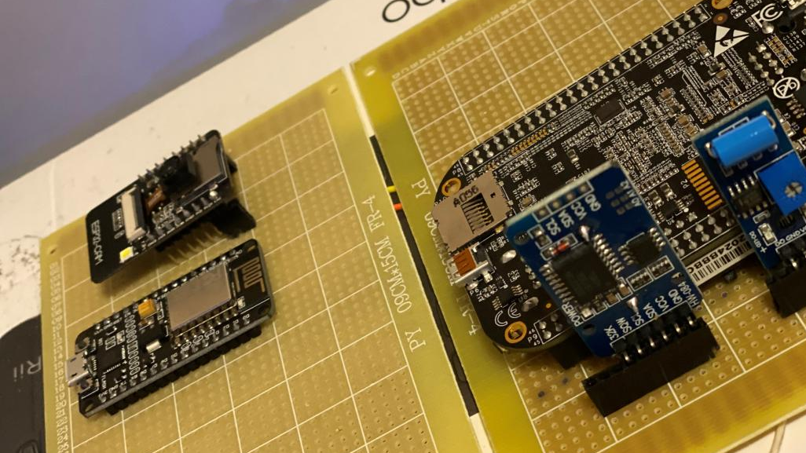
PROJECT OVERVIEW: IOT BASED BANK LOCKER SECURITY SYSTEM
The project is used to improvise the Bank locker security system. It uses various peripherals and sensors for this purpose.
The IOT based Bank locker security system uses an automated Safety vault with a layered defense mechanism.
It uses passcode, fingerprint and camera to manage and control the locker effectively.

Slide 9
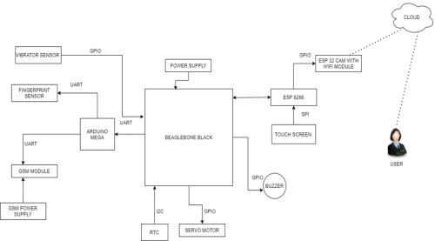
BLOCK DIAGRAM

Slide 10

COMPONENTS USED
Beaglebone black
Arduino Mega
GSM SIM900 Module
ESP32 CAM Module
ESP8266 Module
RTC Module

Slide 11
COMPONENTS USED
Vibration sensor
Fingerprint sensor
Servo motor
Touchscreen
Buzzer

Slide 12
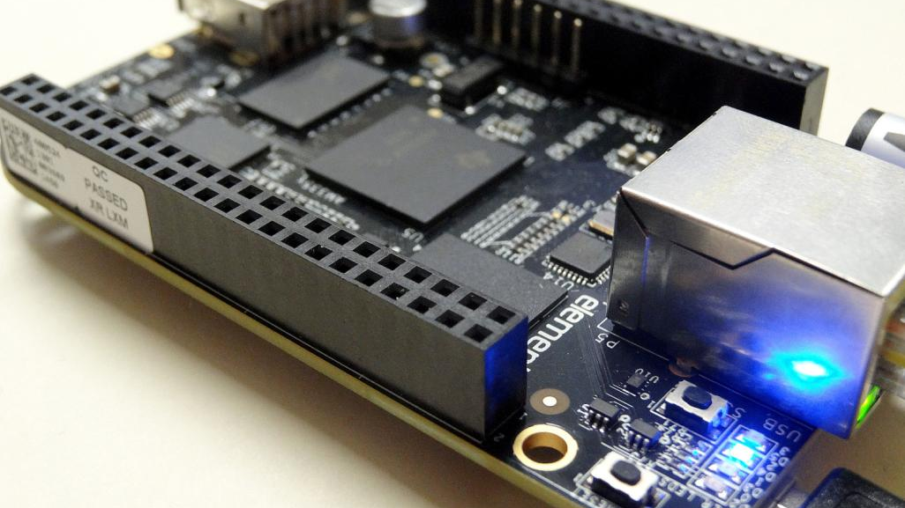
BEAGLEBONE BLACK
BBB is our main microcontroller unit as all the components are connected directly or indirectly to it.
It is a low-cost, community-supported development platform.
This Photo by Unknown Author is licensed under CC BY-NC

Slide 13
HOW TO POWER UP A BEAGLEBONE BLACK??
The board can be powered from four different sources:
A USB port on a PC
A 5VDC 1A power supply plugged into the DC connector.
A power supply with a USB connector.
Expansion connectors

Slide 14
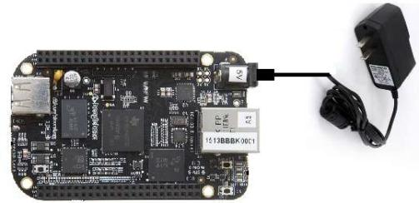
POWER SUPPLY FOR BEAGLEBONE BLACK
The beaglebone black require 5V DC power supply to the DC power jack as shown in the figure.

Slide 15
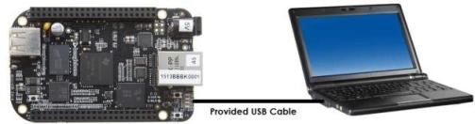
POWER SUPPLY FOR BEAGLEBONE BLACK
In this configuration, the board is powered by the PC via the provided USB cable—no other cables are required.

Slide 16
HOW TO POWER UP A BEAGLEBONE BLACK ??
The USB cable is shipped with each board. This port is limited to 500mA by the Power Management IC. It is possible to change the settings in the TPS65217C to increase this current, but only after the initial boot. And, at that point the PC most likely will complain, but you can also use a dual connector USB cable to the PC to get to 1A.
The power supply is not provided with the board but can be easily obtained from numerous sources. A 1A supply is sufficient to power the board, but if there is a cape plugged into the board or you have a power-hungry device or hub plugged into the host port, then more current may needed from the DC supply.

Slide 17
MODES OF BEAGLEBONE BLACK
THE BELOW MENTIONED ARE THE FUNCTIONAL MODES OF THE DEVICE :
OFF State
Active State
Sleep State
Reset State

Slide 18
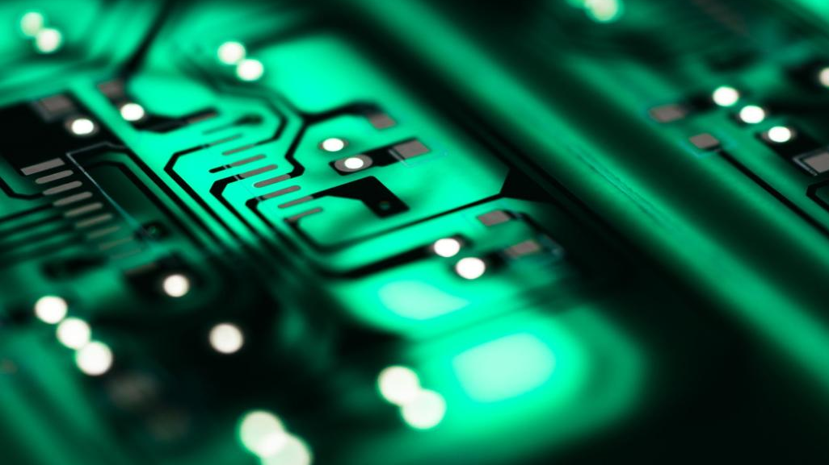
OFF STATE
In the OFF state, the PMIC is completely shut down except for a few circuits to monitor the voltage on the AC, USB, and PB_IN pins. All output power rails are turned off and the registers are reset to their default values. The I2C communication interface is turned off.
To exit the OFF state, one of the following wake-up events must occur:
• The PB_IN pin is pulled low.
• The USB supply is connected (positive edge).
• The AC adapter is connected (positive edge).

Slide 19
ACTIVE STATE
This state is the typical mode of operation when the system is up and running. All DC/DC converters, LDO regulators, load switches, the WLED driver, and the battery charger are operational and can be controlled through the I2C interface.
The PWR_EN pin must be pulled low for the device to go from ACTIVE state.

Slide 20
SLEEP STATE
The SLEEP state is a low-power mode of operation intended to support system standby. Typically, all power rails are turned off except for the LDO1 rail, and the registers are reset to their default values. The LDO1 rail stays operational but can support only a limited amount of current (1 mA typical).
The device goes to the ACTIVE state after detecting a wake-up event as described in the previous sections.

Slide 21
RESET STATE
The device can be reset by either pulling the nRESET pin low or by holding the PB_IN pin low for more than 8 s. All rails are shut down by the sequencer and all register values are reset to their default values. Rails not controlled by the sequencer are shut down after the power-down sequencer is complete. The device stays in this state for as long as the reset pin is held low, and the nRESET pin must be high for the device to go from the RESET state.

Slide 22
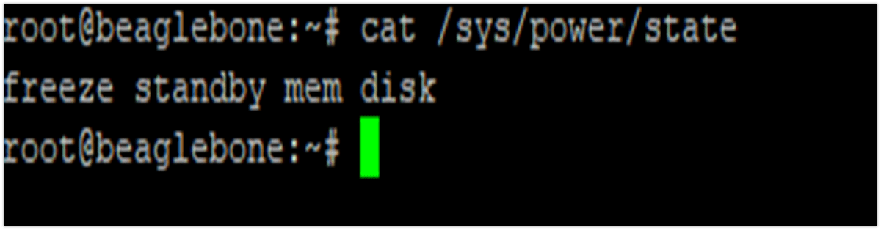
STATES OF BEAGLEBONE BLACK
Freeze
Standby
Mem
Disk

Slide 23
STATES OF BEAGLEBONE BLACK
Standby
ACPI state S1. This state offers minimal, though real, power savings, while providing a very low-latency transition back to a working system. This is the default mode.
Freeze
The processes are frozen, all the devices are suspended, and all the processors idled. This state is a general state that does not need any platform-specific support, but it saves less power than Suspend-to-RAM, because the system is still in a running state. (Available since Linux 3.9.)

Slide 24
STATES OF BEAGLEBONE BLACK
Mem
ACPI state S3 (Suspend-to-RAM). This state offers significant power savings as everything in the system is put into a low-power state, except for memory, which is placed in self-refresh mode to retain its contents.
Disk
ACPI state S4 (Suspend-to-disk). This state offers the greatest power savings and can be used even in the absence of low-level platform support for power management. This state operates similarly to Suspend-to-RAM but includes a final step of writing memory contents to disk.

Slide 25
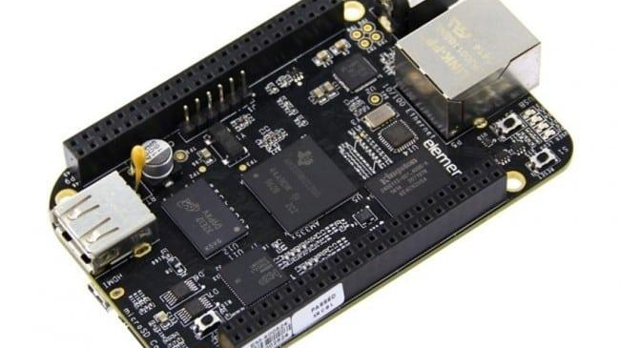
HOW TO PUT BEAGLEBONE BLACK ON SLEEP MODE ??
To put beaglebone on the sleep we connected the beaglebone black with the laptop using the USB cable. It required GNU nano editor, terminal and GCC compiler. In the upcoming slides, sleep mode is demonstrated.
This Photo by Unknown Author is licensed under CC BY-SA

Slide 26
LIBRARIES INCLUDED
stdio.h
Standard C input Output Library.
string.h
C Library for various String Operations.
stdlib.h
header defines four variable types, several macros, and various functions for performing general functions.

Slide 27
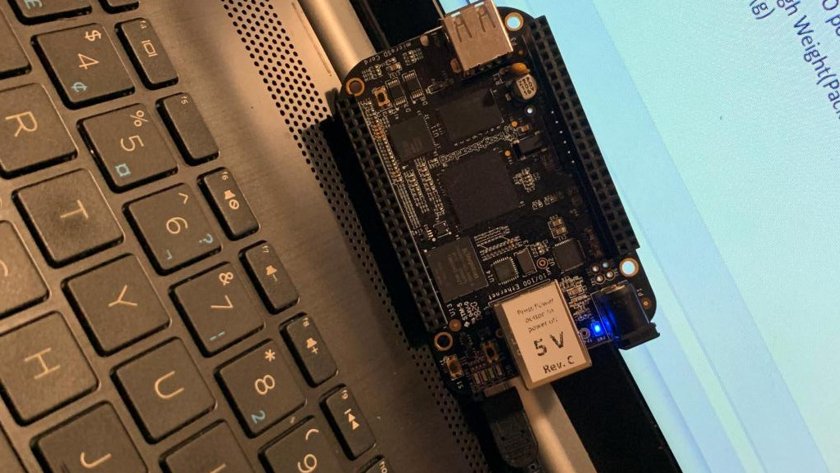
CONNECTION

Slide 28
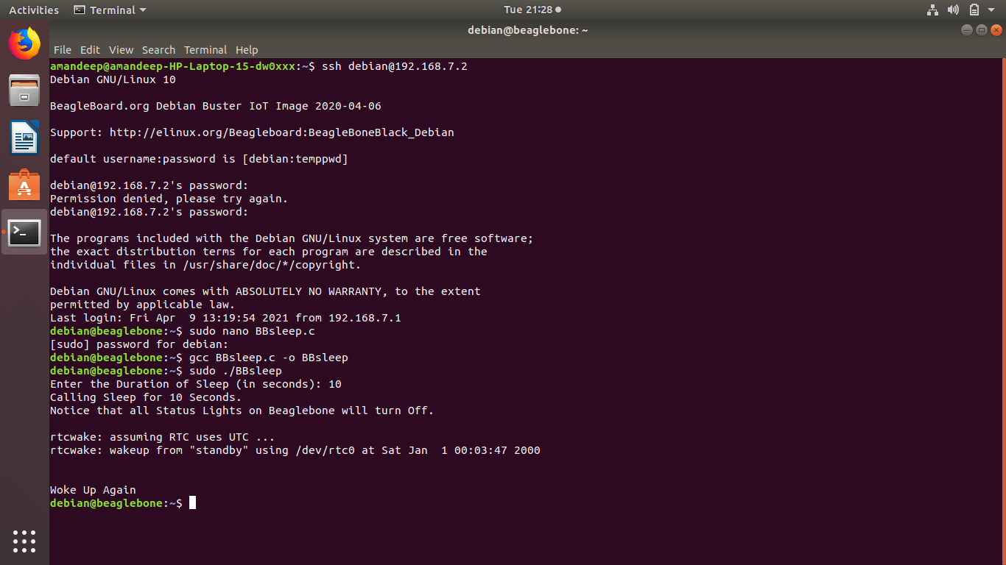
TERMINAL COMMANDS

Slide 29
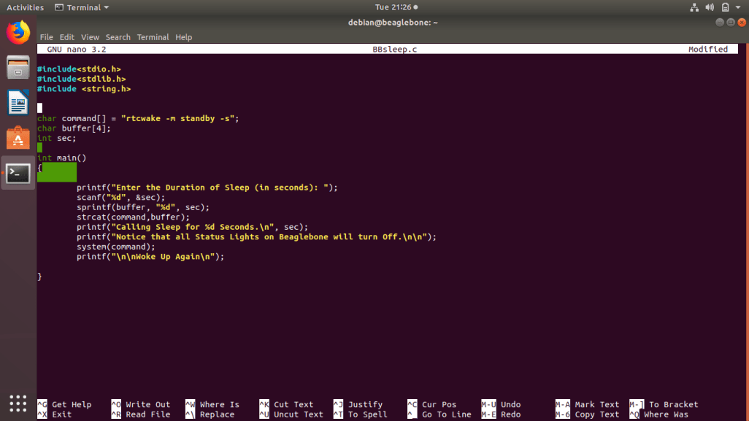
CODING

Slide 30
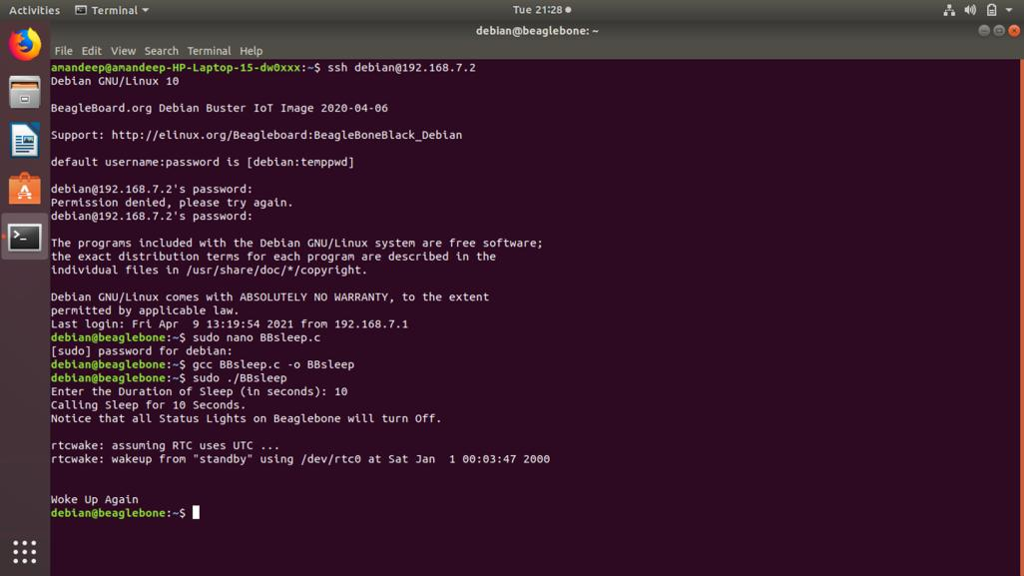
OUTPUT

Slide 31
OUTPUT POWER BY BEAGLEBONE BLACK
Power 5V VDD can provides upto 1000mA current Max
Power 5V sys can provide 250 mA current max
Power 3.3V can provide upto 250mA current max
VDD_ADC (1.8V) can provide 250mA
All I/O pins 3.3V can provide maximum 250mA
AIN pins 1.8V (small current should be drawn from these pins)

Slide 32
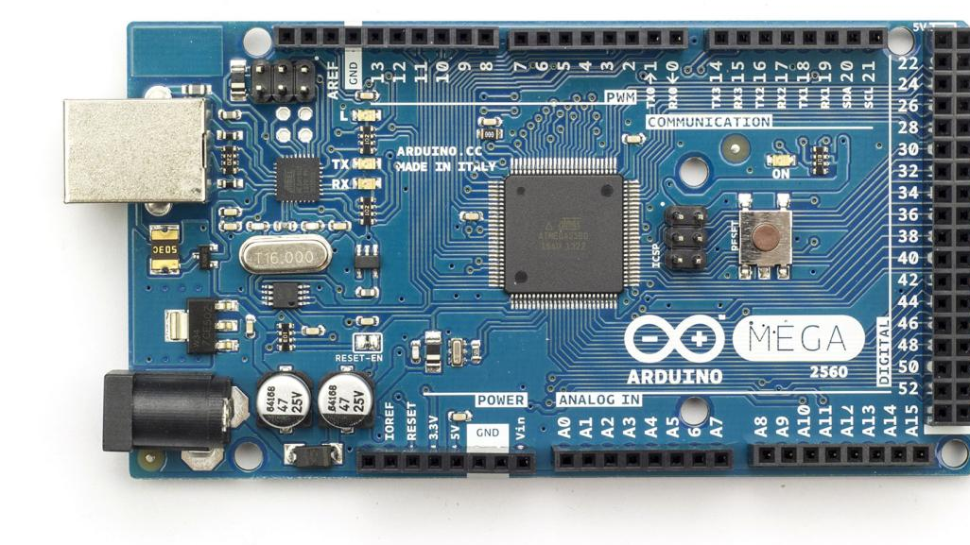
ARDUINO MEGA
Arduino Mega is the slave device in our system for connecting GSM Module and fingerprint sensor.
It is a microcontroller based on the ATmega2560.
The Arduino Mega can be powered via the USB connection or with an external power supply. The power source is selected automatically.
This Photo by Unknown Author is licensed under CC BY-SA-NC

Slide 33
POWER REQUIREMENT FOR ARDUINO MEGA
Operating Voltage | 5V
Input Voltage (recommended) | 7-12V
Input Voltage (limit) | 6-20V
Digital I/O Pins | 54 (of which 15 provide PWM output)
Analog Input Pins | 16
DC Current per I/O Pin | 20 mA
DC Current for 3.3V Pin | 50 mA

Slide 34
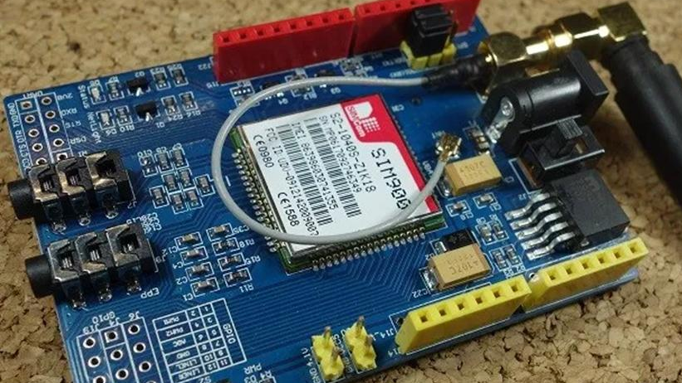
GSM SIM900 MODULE
GSM stands for Global System for Mobile Communications and is the global standard for mobile communications.
The GSM GPRS shield is particularly useful as it allows to:
Connect to the Internet over GPRS network
Send and receive SMS
Place and receive phones calls

Slide 35
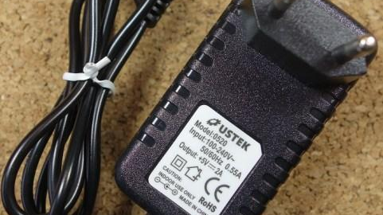
POWER REQUIREMENT FOR GSM SIM900 MODULE
To power up the shield, it is advisable to use a 5V power supply that can provide 2A as the one shown below. It can also be powered with 9V 1A, or 12V 1A.

Slide 36
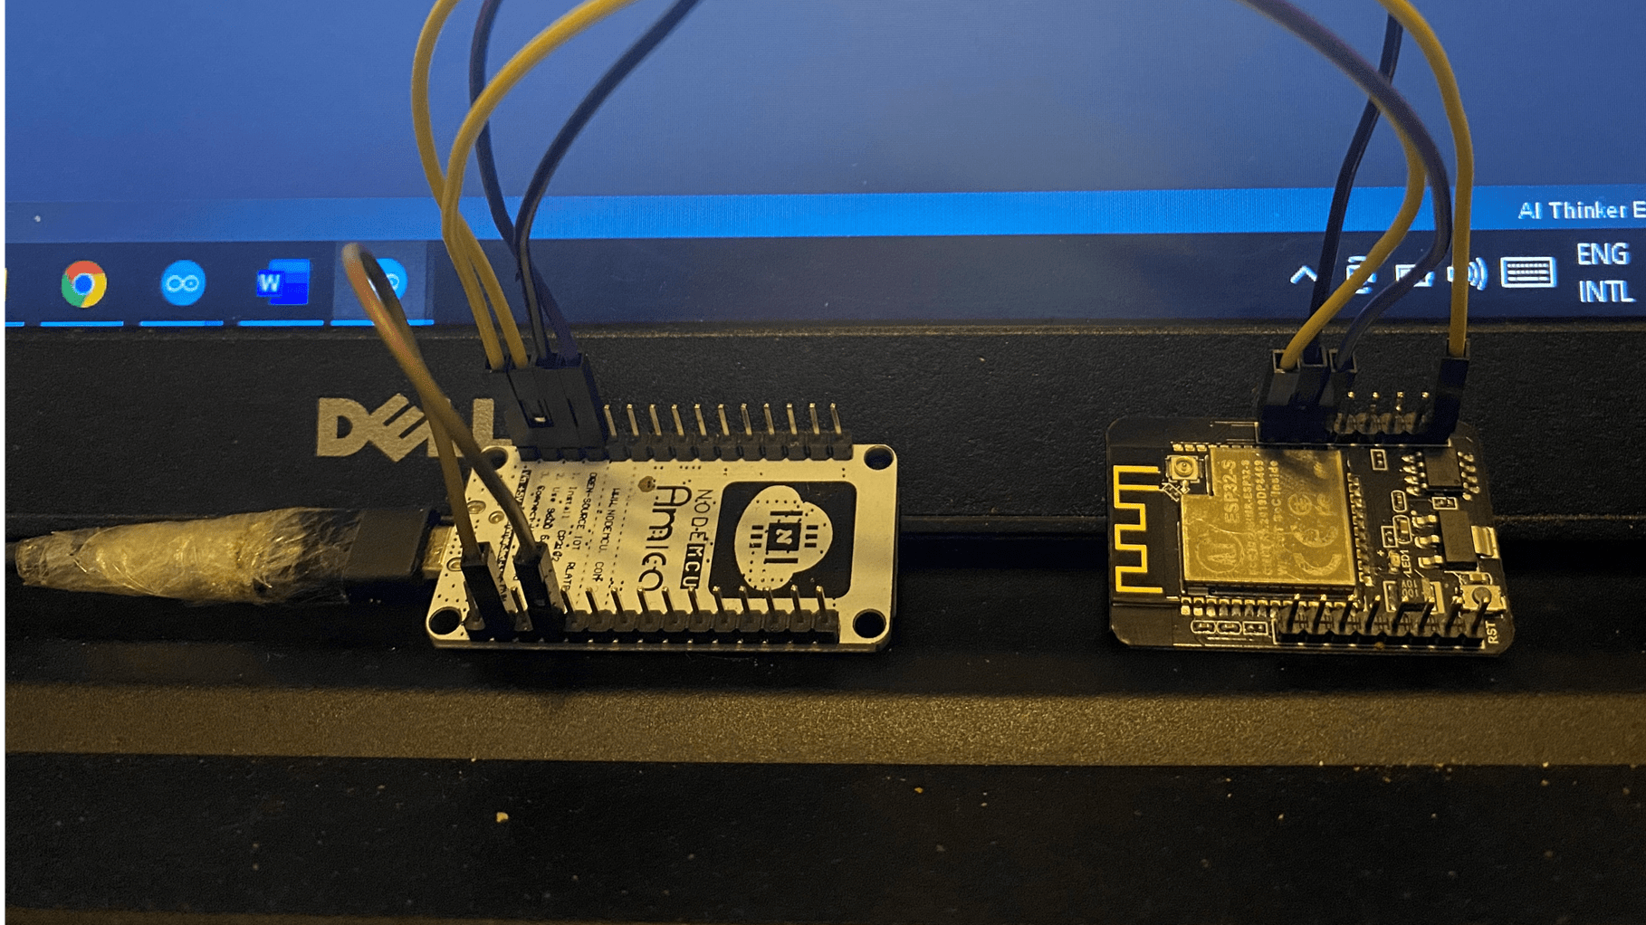
ESP32 CAM MODULE
We are making an IoT based project.
So, it requires internet connectivity.
As Beaglebone Black does not have an inbuilt Wi-fi module, we are using and external module.
ESP32 CAM Module is used for taking picture and sending mail.

Slide 37
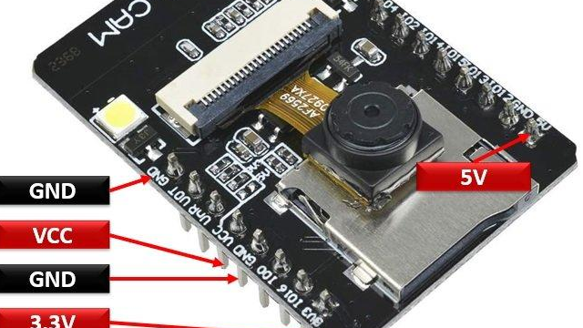
POWER REQUIREMENT FOR ESP32 CAM MODULE
The module has three ground pins and two positive power supply pins such as 5V and 3.3V pins. In this project, 3.3V is used to powerup the device.

Slide 38
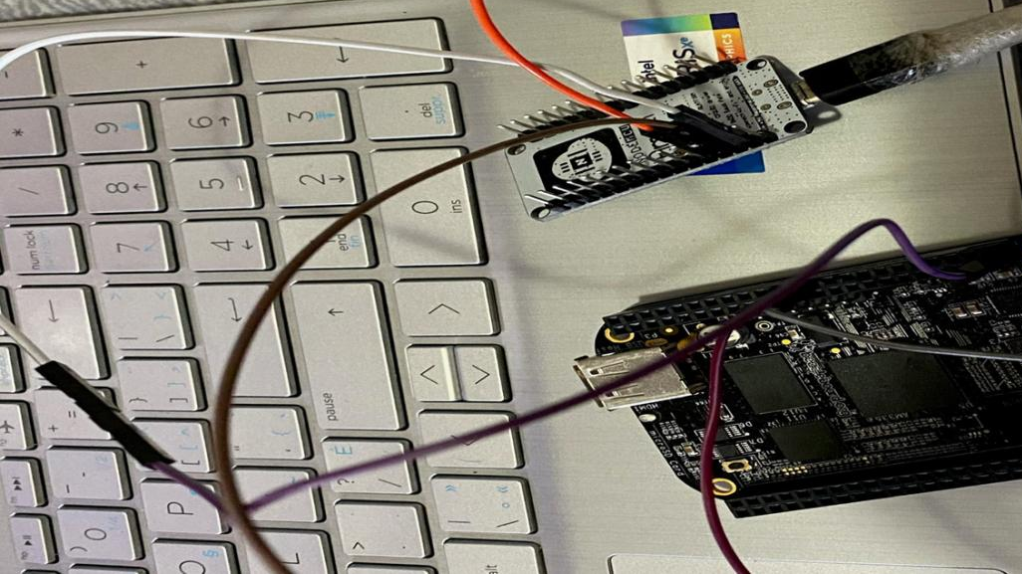
ESP8266 MODULE
NodeMCU is an open-source Lua based firmware and development board specially targeted for IoT based Applications. It includes firmware that runs on the ESP8266 Wi-Fi SoC from Espressif Systems, and hardware which is based on the ESP-12 module.
We are using ESP8266 in our project for touchscreen interface.

Slide 39
Pin Category | Name | Description
Power | Micro-USB, 3.3V, GND, Vin | Micro-USB: NodeMCU can be powered through the USB port 3.3V: Regulated 3.3V can be supplied to this pin to power the board GND: Ground pins Vin: External Power Supply
Control Pins | EN, RST | The pin and the button resets the microcontroller
Analog Pin | A0 | Used to measure analog voltage in the range of 0-3.3V
GPIO Pins | GPIO1 to GPIO16 | NodeMCU has 16 general purpose input-output pins on its board
SPI Pins | SD1, CMD, SD0, CLK | NodeMCU has four pins available for SPI communication.
UART Pins | TXD0, RXD0, TXD2, RXD2 | NodeMCU has two UART interfaces, UART0 (RXD0 & TXD0) and UART1 (RXD1 & TXD1). UART1 is used to upload the firmware/program.
I2C Pins |  | NodeMCU has I2C functionality support but due to the internal functionality of these pins, you have to find which pin is I2C.

Slide 40
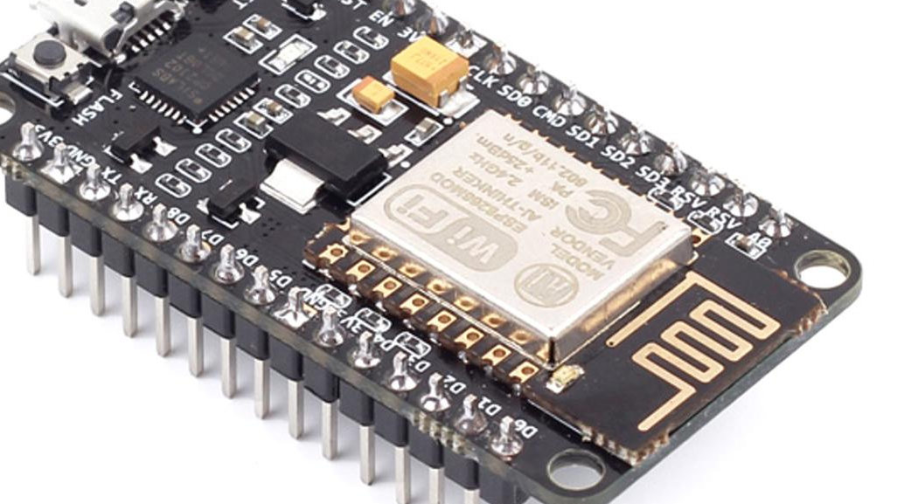
HARDWARE SPECIFICATIONS
Operating Voltage: 2.5V ~ 3.6V
Operating Current: Average value: 80 mA
Operating Temperature Range: –40°C ~ 125°C
Package Size: QFN32-pin (5 mm x 5 mm)
This Photo by Unknown Author is licensed under CC BY-SA

Slide 41
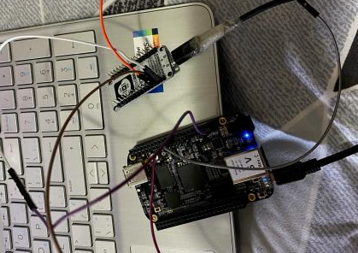
POWER REQUIREMENT FOR ESP8266 MODULE
ESP8266EX is designed with advanced power management technologies and intended for mobile devices, wearable electronics and the Internet of Things applications. The low-power architecture operates in the following modes:
• Active mode: The chip radio is powered on. The chip can receive, transmit, or listen.
• Modem-sleep mode: The CPU is operational. The Wi-Fi and radio are disabled.
• Light-sleep mode: The CPU and all peripherals are paused. Any wake-up events
(MAC, host, RTC timer, or external interrupts) will wake up the chip.
• Deep-sleep mode: Only the RTC is operational and all other part of the chip are powered off.

Slide 42
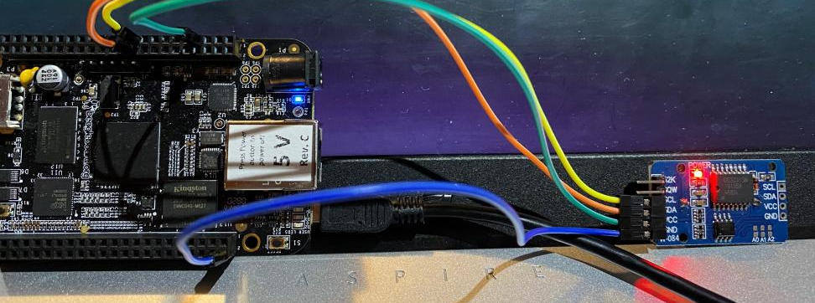
RTC MODULE
Real time clock (RTC) allows microcontroller project to keep track of time.
We are using RTC for keeping track or real time.

Slide 43
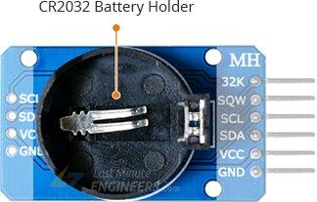
POWER REQUIREMENT FOR RTC MODULE
RTC incorporates a battery input and maintains accurate timekeeping when main power to the device is interrupted. The bottom side of the board holds a battery holder for 20mm 3V lithium coincells. Any CR2032 battery can fit well.

Slide 44
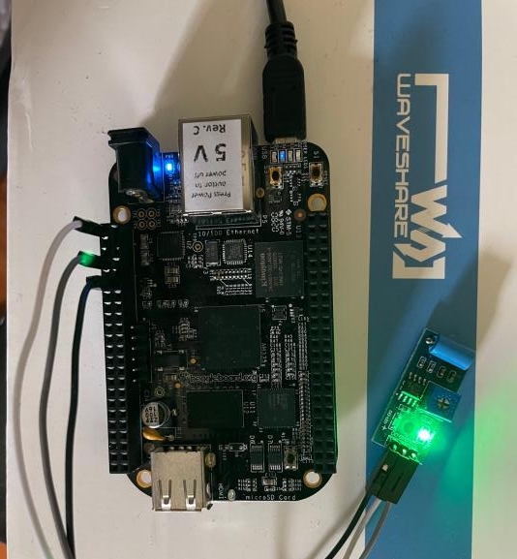
VIBRATION SENSOR
The Vibration sensor is used to detect if there is any vibration that is beyond the threshold. The threshold can be adjusted by the on-board potentiometer. When there no vibration, this module output logic LOW the signal indicate LED light, and vice versa.
It is used in our project to detect vibration as when somebody will try to open the bank locker forcefully, this sensor will start vibrating.

Slide 45
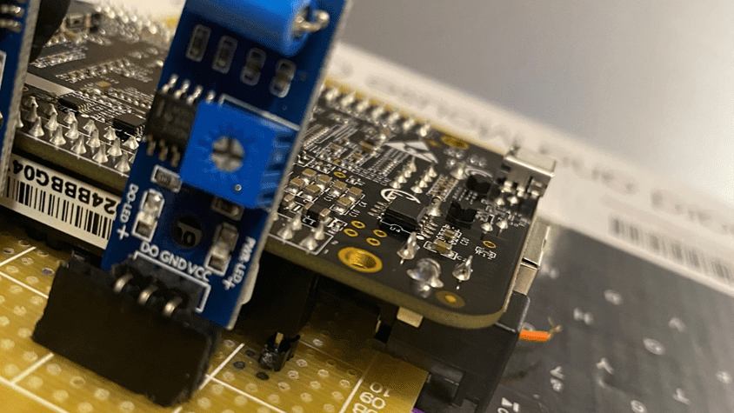
POWER REQUIREMENT FOR VIBRATION SENSOR
The default state of the switch is close
Digital output Supply voltage:3.3V-5V
On-board indicator LED to show the results
Dimension of the board: 3.2cm x 1.4cm

Slide 46
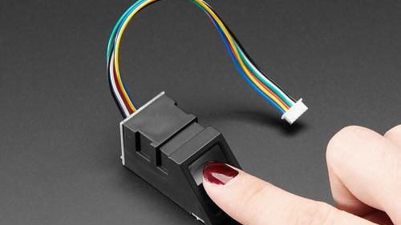
FINGERPRINT SENSOR
The R307 Optical Fingerprint Module integrates fingerprint algorithm chip with functions such as fingerprint entry, image processing, feature extraction, template generation, template storage, fingerprint comparison (1:1) and fingerprint search (1:N).
Fingerprint reader can conduct secondary development and can be embedded into various end products such as: access control, attendance, safety deposit box, car door locks.
This Photo by Unknown Author is licensed under CC BY-SA-NC

Slide 47
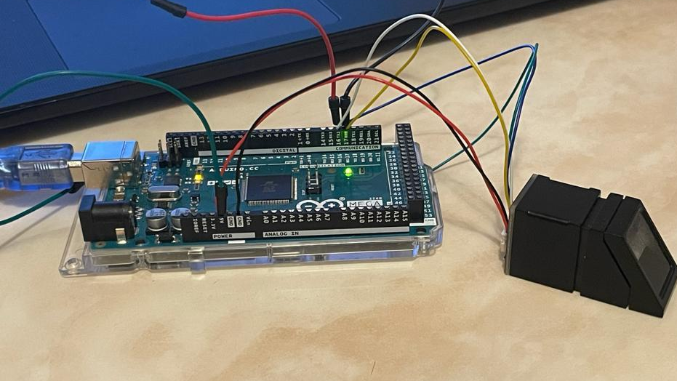
POWER REQUIREMENT FOR FINGERPRINT SENSOR
Power DC 4.2V-6V
Interface UART
Working current Typical: 50mA
Baud rate (9600*N)bps
Character file size 256 bytes
Image acquiring time <0.5s

Slide 48
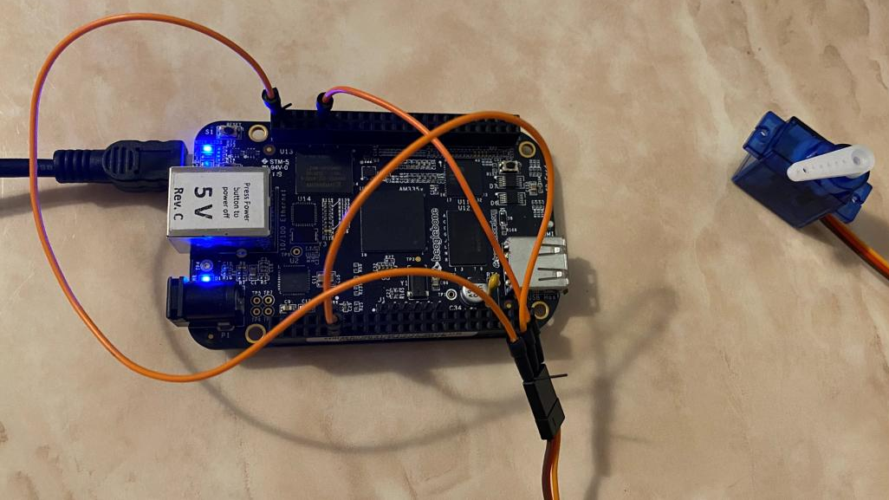
SERVO MOTOR
It is used in our project for lock open and close mechanism.

Slide 49
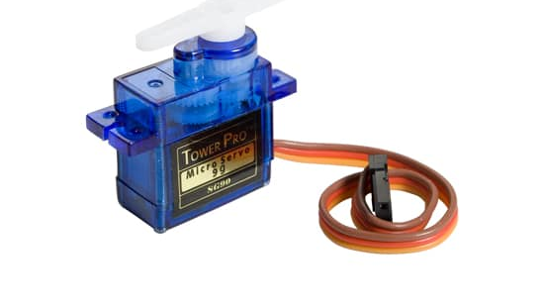
POWER REQUIREMENT FOR SERVO MOTOR
Operating Voltage is +5V typically
Torque: 2.5kg/cm
Operating speed is 0.1s/60°
Gear Type: Plastic
Rotation : 0°-180°
Weight of motor : 9gm
This Photo by Unknown Author is licensed under CC BY-SA

Slide 50
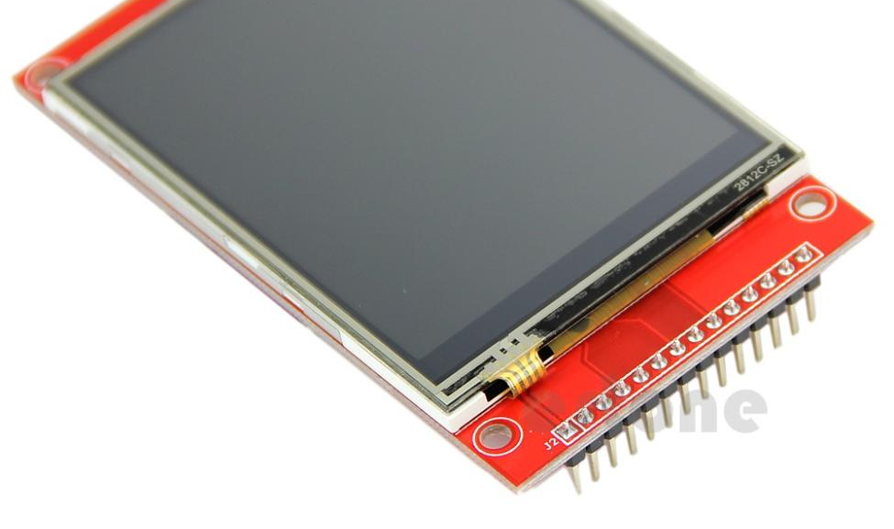
TOUCHSCREEN
2.8-inch screen
Capacitive/Resistive touch control
Supports popular mini-PCs such as Raspberry Pi, BB Black, as well as general desktop computers
This Photo by Unknown Author is licensed under CC BY-SA

Slide 51
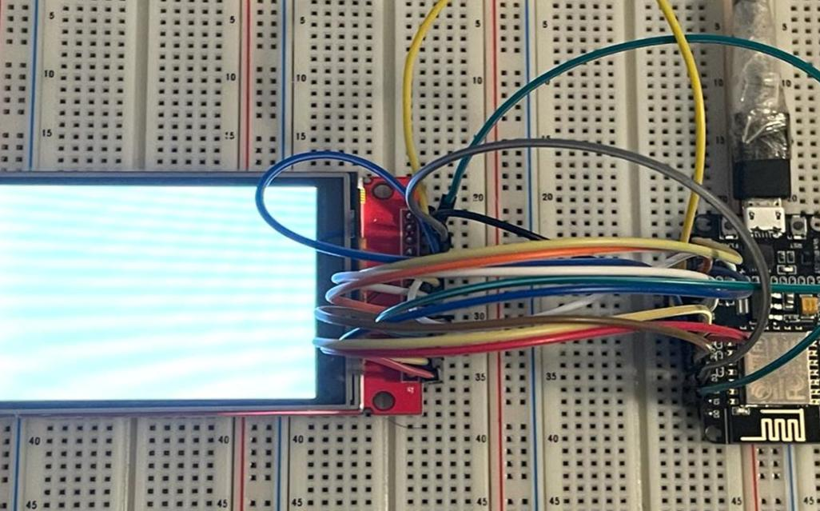
POWER REQUIREMENT FOR TOUCHSCREEN
Operating Temperature 20℃~60℃
Storage Temperature 30℃~70℃
VCC power voltage 3.3V~5V
Logic IO port voltage 3.3V(TTL)
Rough Weight(Package containing) No touch: 34(g) / With touch: 43(g)

Slide 52
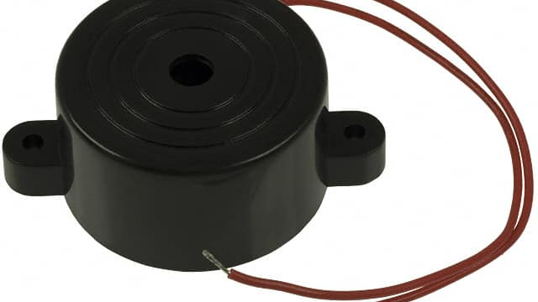
BUZZER
A buzzer or beeper is an audio signalling device, which may be mechanical, electromechanial, or piezoelectric (piezo for short). Typical uses of buzzers and beepers include alarm devices, timers, and confirmation of user input such as a mouse click or keystroke.
This buzzer is used to give an alert sound when somebody fails to enter the passcode and fingerprints are not matched.
This Photo by Unknown Author is licensed under CC BY-SA

Slide 53
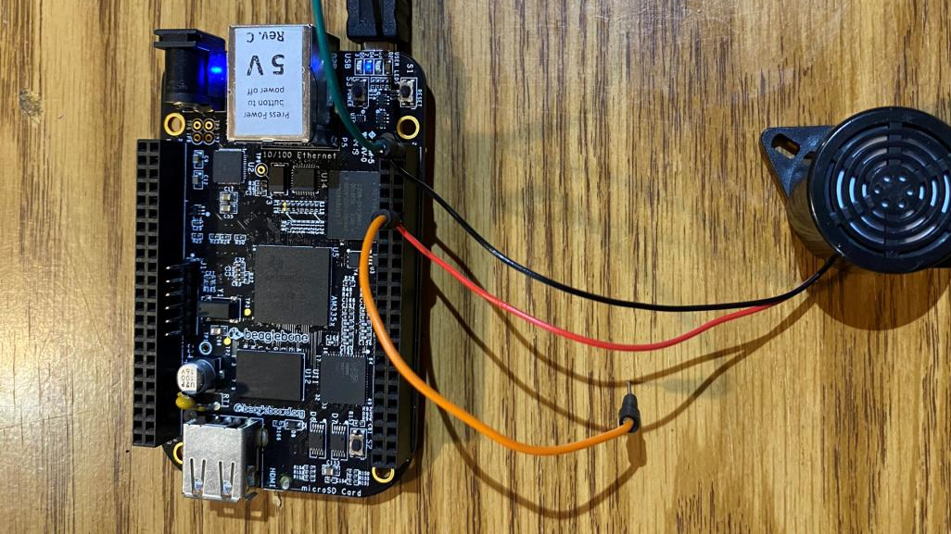
POWER REQUIREMENT FOR BUZZER
Rated Voltage : 6V DC
Operating Voltage : 4V DC to 8V DC
Max. Rated Current : 30mA / 6V DC
Min. Sound Pressure Level : 80dB/20cm
Resonant Frequency : 400Hz ±100Hz
Response Time : 50ms

Slide 54
REFERENCES
BEAGLEBONE BLACK: https://stackoverflow.com/questions/38601376/hibernate-a-beaglebone-black
https://cdn-shop.adafruit.com/datasheets/BBB_SRM.pdf
ARDUINO MEGA: https://store.arduino.cc/usa/mega-2560-r3
GSM SIM900 MODULE: SIM900 GSM GPRS Shield with Arduino | Random Nerd Tutorials
Fingerprint Sensor: (electronicscomp.com)
ESP32 CAM Module: ESP32-CAM AI-Thinker: Pinout, GPIO Pins, Features and How to Program (microcontrollerslab.com)

Slide 55
REFERENCES
Vibration Sensor: SW-420 Vibration Sensor Module Pinout, Datasheet, Features & Specifications (components101.com)
Touchscreen: Interfacing 2.8 INCH TFT LCD Touch Screen with ESP32 (electropeak.com)
Buzzer: http://www.farnell.com/datasheets/1760524.pdf
Servo motor: http://www.ee.ic.ac.uk/pcheung/teaching/DE1_EE/stores/sg90_datasheet.pdf
ESP8266 Module: https://circuits4you.com/2019/01/13/esp8266-absolute-maximum-ratings/

Slide 56
THANK YOU

